Slide 1
Opening restaurant in San Francisco
By:
Krishna teja perannagari

Slide 2
Introduction

Slide 3
Background
San Francisco being a densely populated business centre has a lot of demand for restaurants and food-service operators due to the changing preference of residents to dine out or take prepared food home.
Though the future looks bright for the food-service industry overall, there are no guarantees in this business and San Francisco, is seeing more restaurants fail fast for a number of reasons.
Despite being lauded as one of the top food cities in countless articles, the city is also one of the toughest markets in the U.S. to operate a business.
The traffic congestion combined with the Netflix effect is keeping people indoor paying way for delivery services to act as a potential threat to the local restaurants.

Slide 4
Business Problem
Identify the right location that will have more footfall and scope to serve the customers through delivery without facing much traffic congestion.
Identifying the right cuisine for the menu that will give us a competitive edge in the market. By keeping the menu limited to one cuisine restaurant can more efficiently plan for labour costs, can serve a lot more guests and improve bottom-line profit.
Identifying the facilities and amenities to be provided to overcome the Netflix influence. Amenities provided by the restaurants such as parking, restroom, Wi-Fi etc., also have a significant impact on the customers visiting the restaurant. While providing and maintaining amenities such as parking involve significant costs.

Slide 5
Target customer groups
The solution developed from the current project will help the individuals who are planning to open their own restaurant in San Francisco. It will provide a list of suggestions which if incorporated can improve the profitability of the restaurant.
In the current study we will be focussing on the restaurants situated nearby educational institutions.
Due to the presence of highly reputed educational institutions and job opportunities students from all over the globe come to San Francisco to study.
The money spent on food related expenses by international students is significantly higher and employing the correct positioning strategy will help our restaurant succeed.
Restaurants competing for market share in student segment is lesser than the working class segment.

Slide 6
data

Slide 7
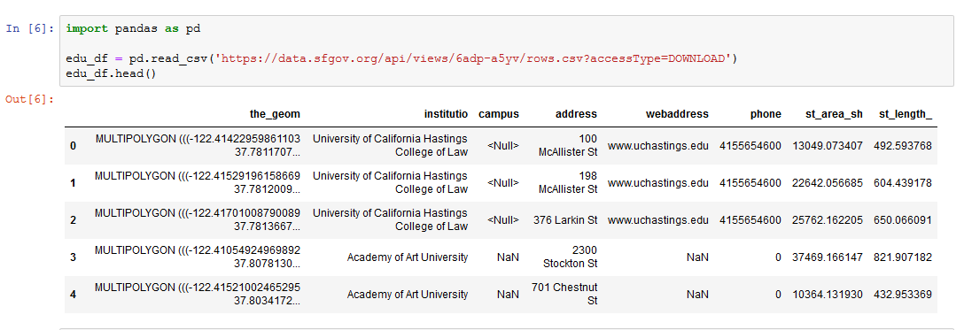
Data about educational institutions in San Francisco
k

Slide 8
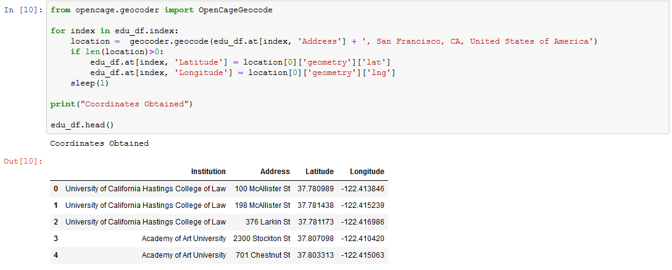
Getting coordinates from OpenCageData
k

Slide 9
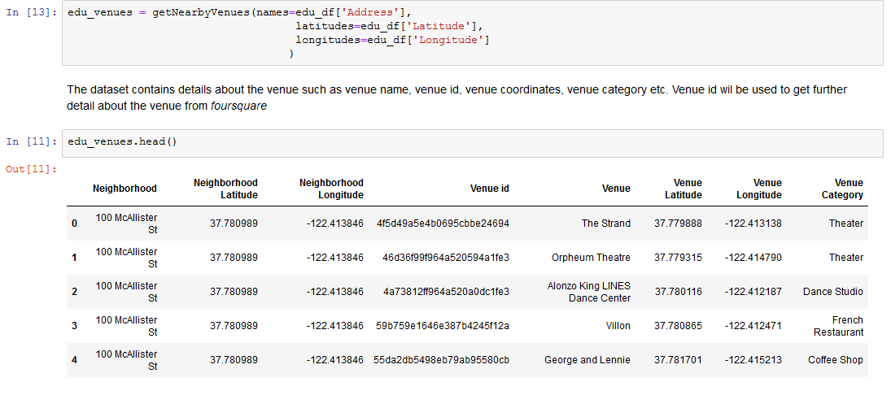
Getting details of popular locations from foursquare

Slide 10
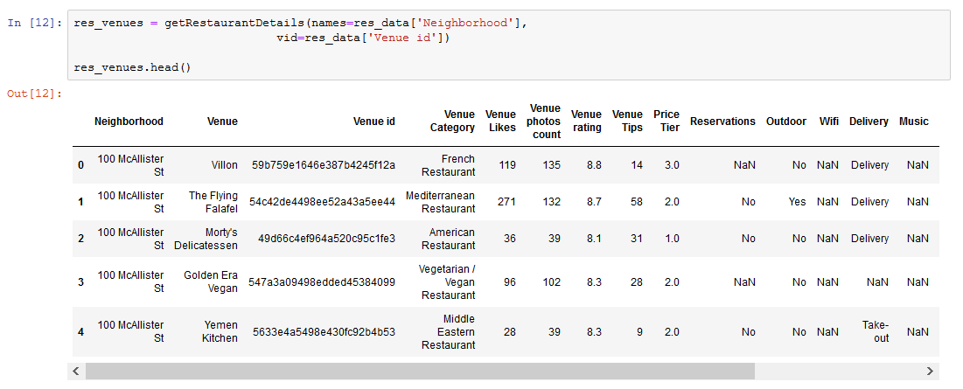
Getting Details of restaurant (facilities & statistics) from foursquare
k

Slide 11
Methodology

Slide 12
Transformations on collected data
Merging the restaurant and education details dataframe
The educational data will be helpful when we will plot the clusters and we are also using institution as one of the parameter for cluster analysis
Dropping unnecessary columns and NA values with mode
We will drop the columns which are not used for cluster analysis. They will be used afterwards for analysing the results. Similarly we are replacing the NA values with mode rather than mean as they are categorical in nature
Coding the categorical variables
We will use LabelEncoder() from sklearn to convert the categorical variables to codes before performing cluster analysis

Slide 13
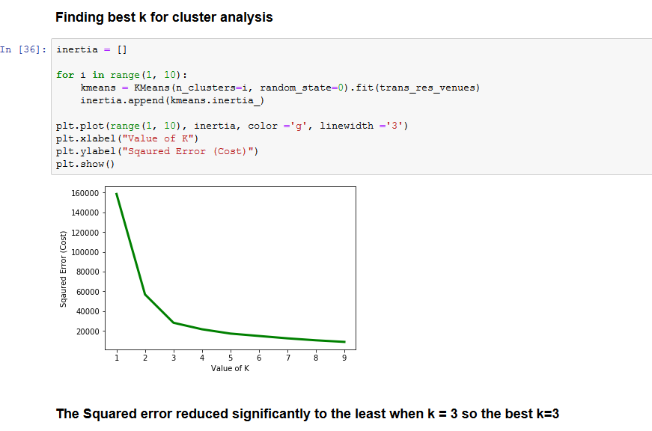
Finding best k for cluster analysis
k

Slide 14
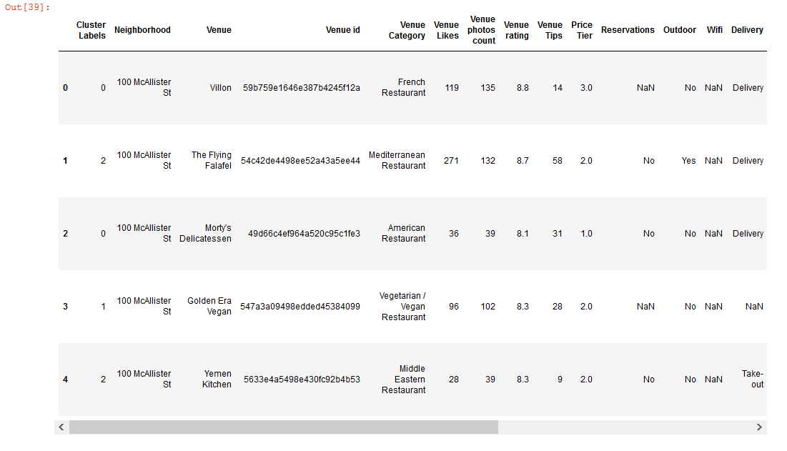
Performing Cluster Analysis
k

Slide 15
Results

Slide 16
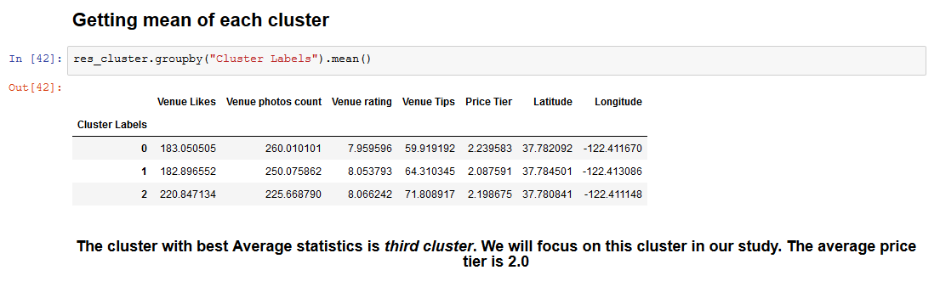
Selecting cluster for further analysis

Slide 17
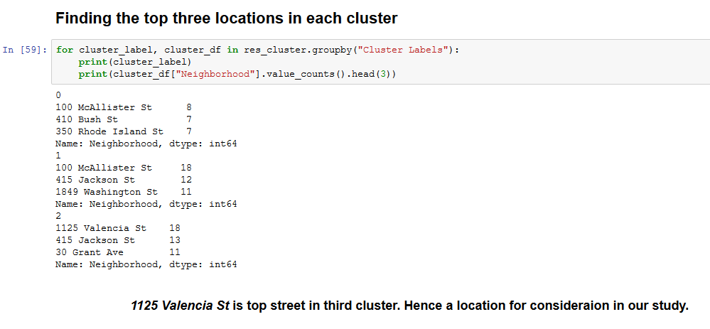
Identifying right location in the cluster
k

Slide 18
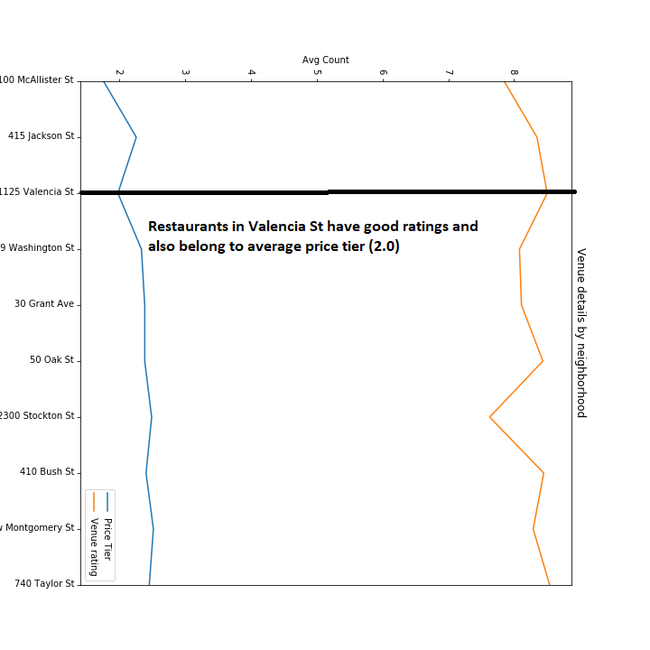
Analysing Valencia ST by price and rating

Slide 19
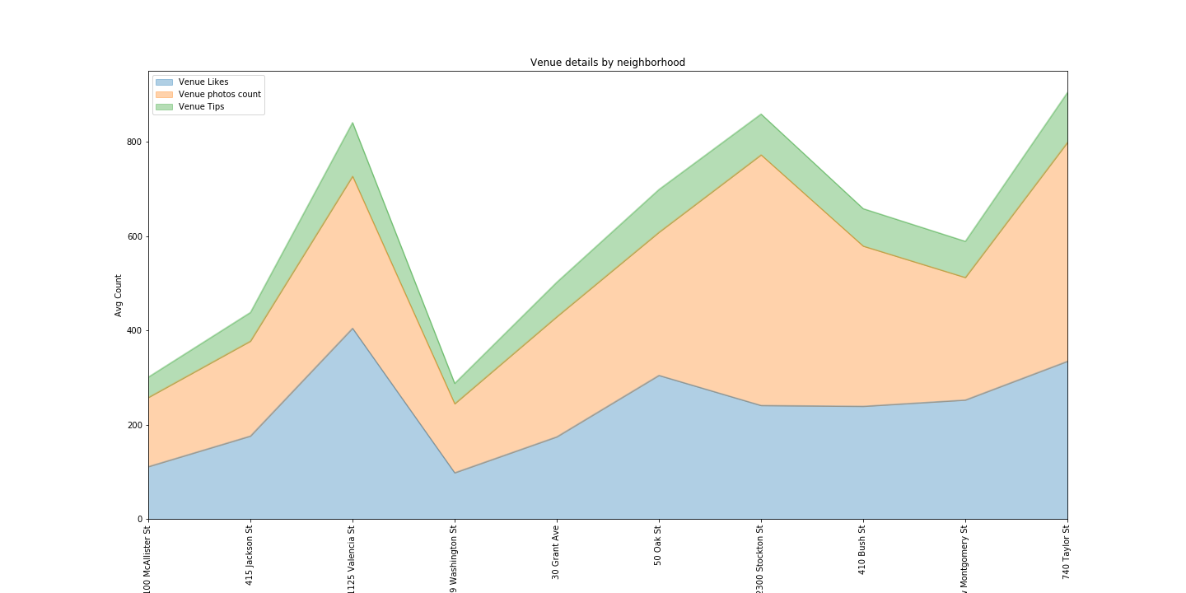
Analysing Valencia ST by likes, photos and tips

Slide 20
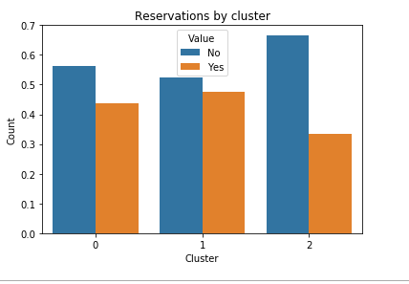
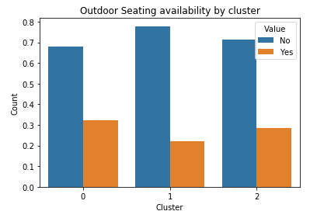
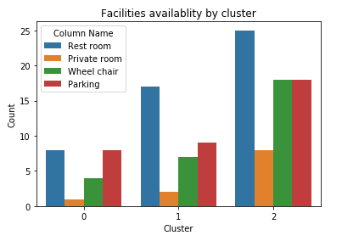
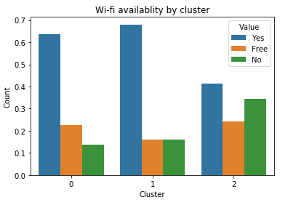
Restaurant facilities in each cluster

Slide 21
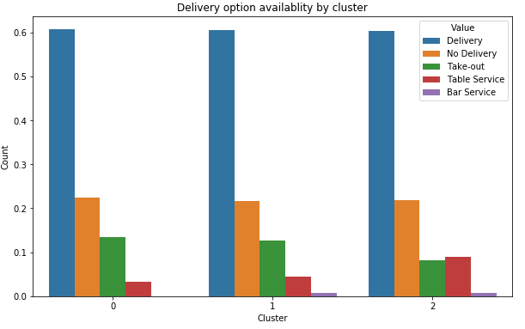
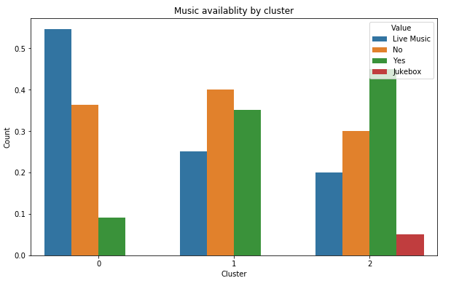
Restaurant facilities in each cluster
k

Slide 22
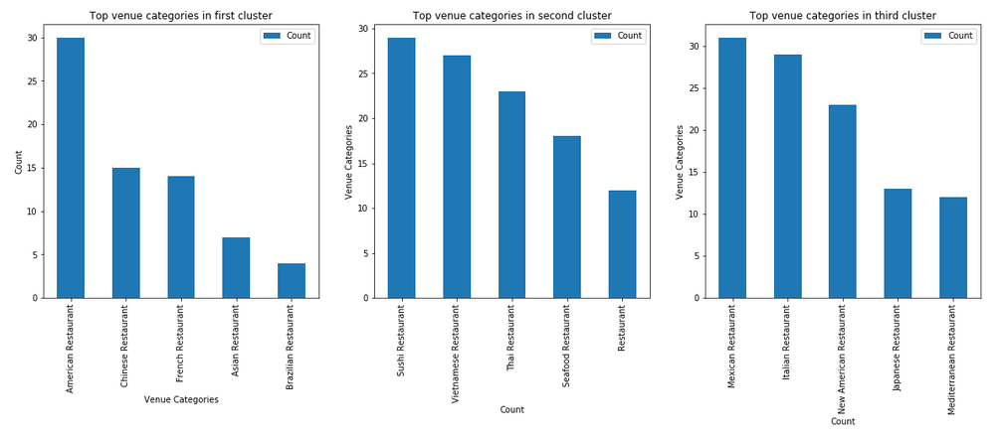
Top venue categories in each cluster
k

Slide 23
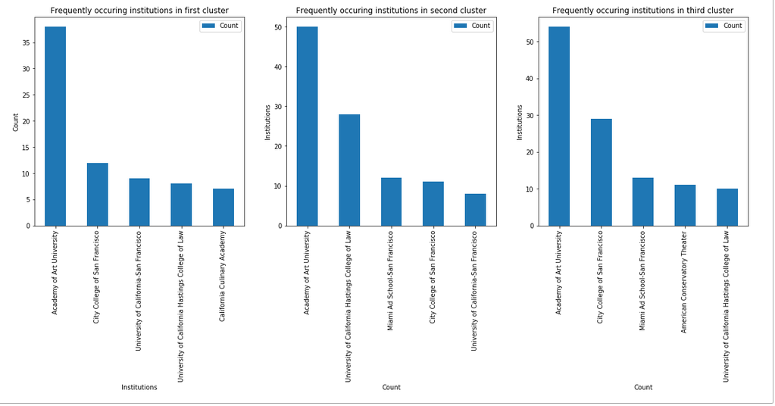
Top institutions in each cluster
k

Slide 24
Discussion

Slide 25
Solutions to problem based on insights from data
We have identified fro the above data that third cluster (Labelled as Cluster 2) has got the maximum likes, ratings and tips. Hence we will be focussing on third cluster to answer the business questions.
“Question 1: Which is the right location for starting a restaurant in San Francisco to serve the maximum number of students?”
1125 Valencia St is the top repeated neighbourhood in cluster 3. It has got good rating and has least prices. This neighbourhood will be the best location to open our restaurant. If cost constraints do not permit this location we can also consider location nearby Academy of Arts University campus.

Slide 26
Solutions to problem based on insights from data
“Question 2: Which cuisine in the menu will provide a competitive edge to in the highly contested San Francisco food services market?”
We have identified Japanese, Mediterranean and Indian cuisines as the most preferred and distinct cuisines in third cluster. Market research indicates that international students come from China and India predominantly in San Francisco Source: USFCA.edu. Hence the restaurant should focus on Indian dishes as one of the predominant target consumer group is international students

Slide 27
Solutions to problem based on insights from data
“Question 3: What type to amenities should be provided to improve customer satisfaction while maintaining the operational cost at the minimum level?”
The average price tier is 2.0 so we will focus only on services that are in high demand and try to excel in providing the services. Based on the above results the facilities provided include Music, parking, rest rooms, wheel chair, delivery and table services.
We will not be providing Wi-Fi, Private rooms, Outdoor seating, reservations

Slide 28
Conclusion

Slide 29
Conclusion
Based on the analysis of the collected data the restaurant should be located in 1125 Valencia St and should serve Indian Dishes
We will be offering both home delivery services and table services.
For offering home delivery service we will partner with Grubhub.com. For home delivery service our main focus will be on convenient affordable service.
For table services we will have indoor seating arrangement with music. We will have facilities such as wheel chair, parking and restrooms. For home delivery service our main focus will be on dining experience.
To reduce expenditure on labour and office space we will not be investing on private room, Wi-Fi, reservation, outdoor seating etc.

Slide 30
THE END

